Slide 1
Digital Image Processing
Image Enhancement
(Histogram Processing)

Slide 2
Contents
Over the next few lectures we will look at image enhancement techniques working in the spatial domain:
What is image enhancement?
Different kinds of image enhancement
Histogram processing
Point processing
Neighbourhood operations

Slide 3
A Note About Grey Levels
So far when we have spoken about image grey level values we have said they are in the range [0, 255]
Where 0 is black and 255 is white
There is no reason why we have to use this range
The range [0,255] stems from display technologes
For many of the image processing operations in this lecture grey levels are assumed to be given in the range [0.0, 1.0]

Slide 4
What Is Image Enhancement?
Image enhancement is the process of making images more useful
The reasons for doing this include:
Highlighting interesting detail in images
Removing noise from images
Making images more visually appealing

Slide 5
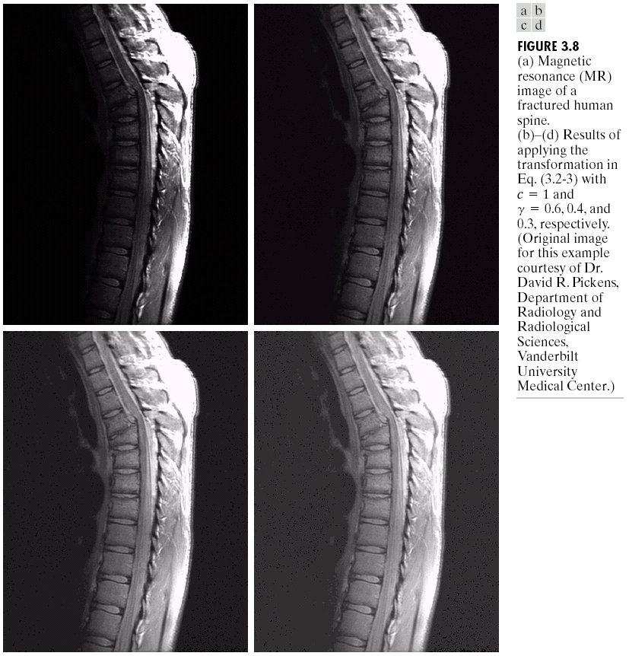
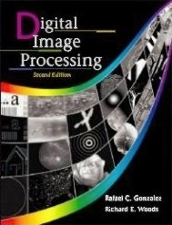
Image Enhancement Examples
Images taken from Gonzalez & Woods, Digital Image Processing (2002)

Slide 6
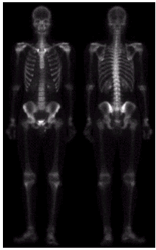
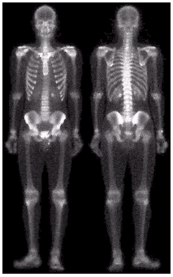
Image Enhancement Examples (cont…)
Images taken from Gonzalez & Woods, Digital Image Processing (2002)

Slide 7
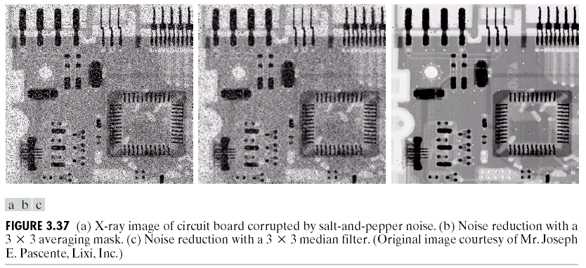
Image Enhancement Examples (cont…)
Images taken from Gonzalez & Woods, Digital Image Processing (2002)

Slide 8
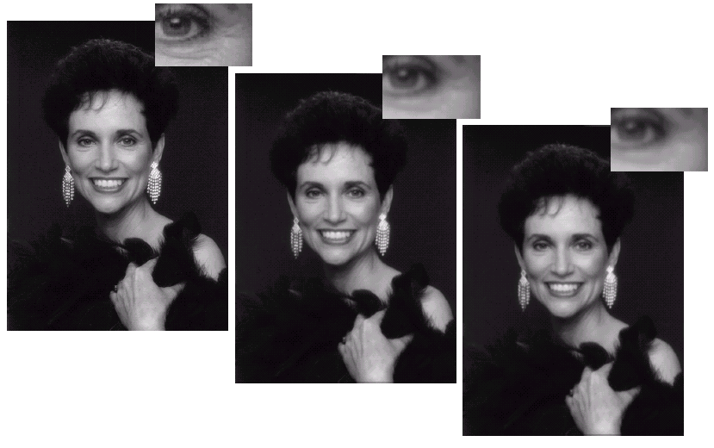
Image Enhancement Examples (cont…)
Images taken from Gonzalez & Woods, Digital Image Processing (2002)

Slide 9
Spatial & Frequency Domains
There are two broad categories of image enhancement techniques
Spatial domain techniques
Direct manipulation of image pixels
Frequency domain techniques
Manipulation of Fourier transform or wavelet transform of an image
For the moment we will concentrate on techniques that operate in the spatial domain

Slide 10
Image Histograms
The histogram of an image shows us the distribution of grey levels in the image
Massively useful in image processing, especially in segmentation
Frequencies
Grey Levels

Slide 11
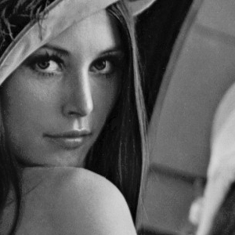
Histogram Examples
Images taken from Gonzalez & Woods, Digital Image Processing (2002)

Slide 12
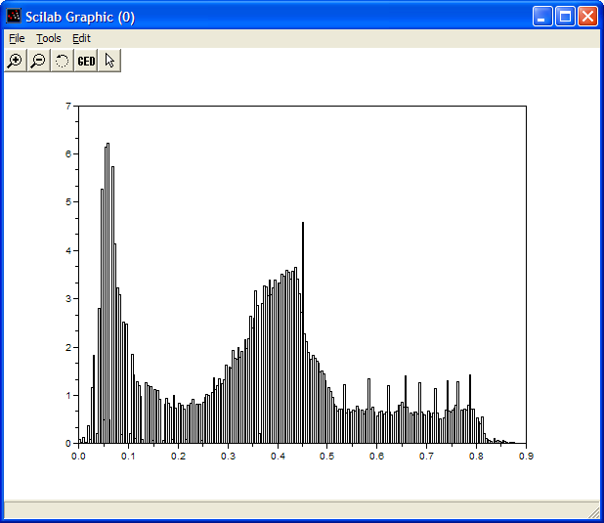
Histogram Examples (cont…)
Images taken from Gonzalez & Woods, Digital Image Processing (2002)

Slide 13

Histogram Examples (cont…)
Images taken from Gonzalez & Woods, Digital Image Processing (2002)

Slide 14
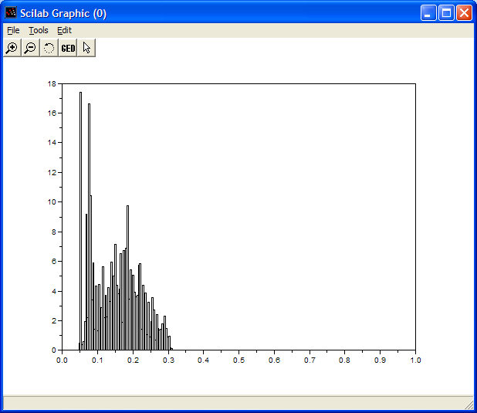
Histogram Examples (cont…)
Images taken from Gonzalez & Woods, Digital Image Processing (2002)

Slide 15
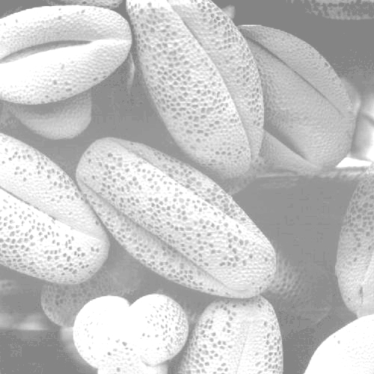
Histogram Examples (cont…)
Images taken from Gonzalez & Woods, Digital Image Processing (2002)

Slide 16
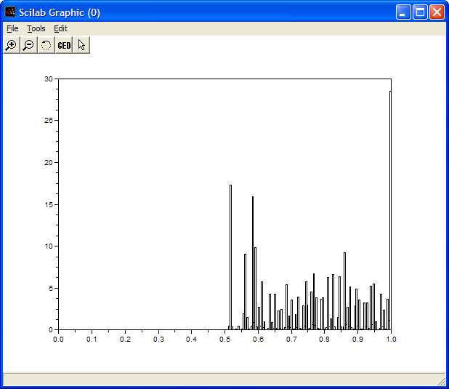
Histogram Examples (cont…)
Images taken from Gonzalez & Woods, Digital Image Processing (2002)

Slide 17

Histogram Examples (cont…)
Images taken from Gonzalez & Woods, Digital Image Processing (2002)

Slide 18
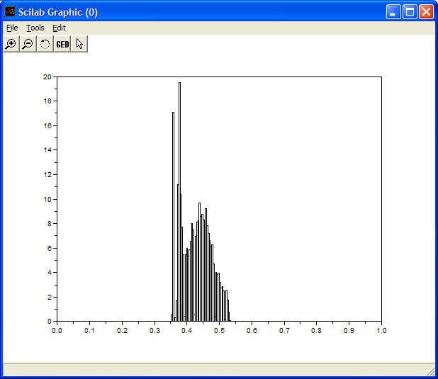
Histogram Examples (cont…)
Images taken from Gonzalez & Woods, Digital Image Processing (2002)

Slide 19
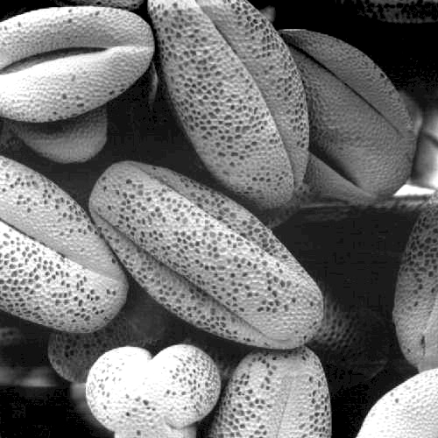
Histogram Examples (cont…)
Images taken from Gonzalez & Woods, Digital Image Processing (2002)

Slide 20
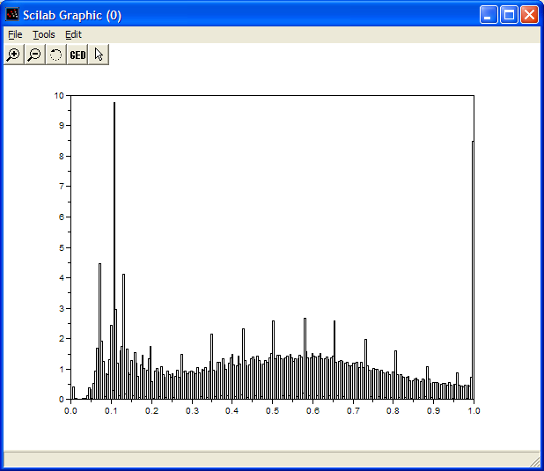
Histogram Examples (cont…)
Images taken from Gonzalez & Woods, Digital Image Processing (2002)

Slide 21
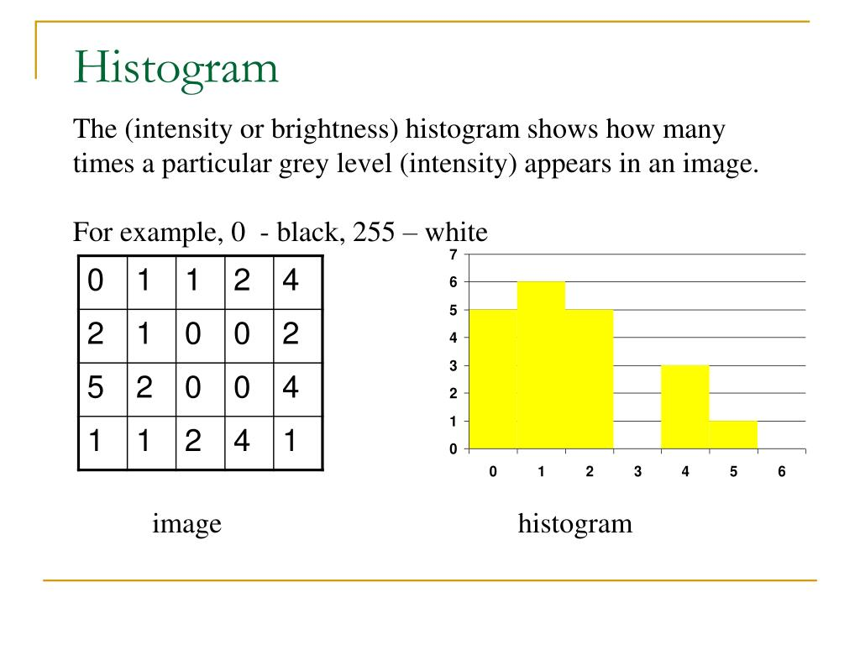

Slide 22
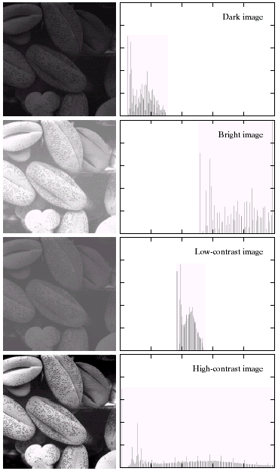
Histogram Examples (cont…)
A selection of images and their histograms
Notice the relationships between the images and their histograms
Note that the high contrast image has the most evenly spaced histogram
Images taken from Gonzalez & Woods, Digital Image Processing (2002)

Slide 23
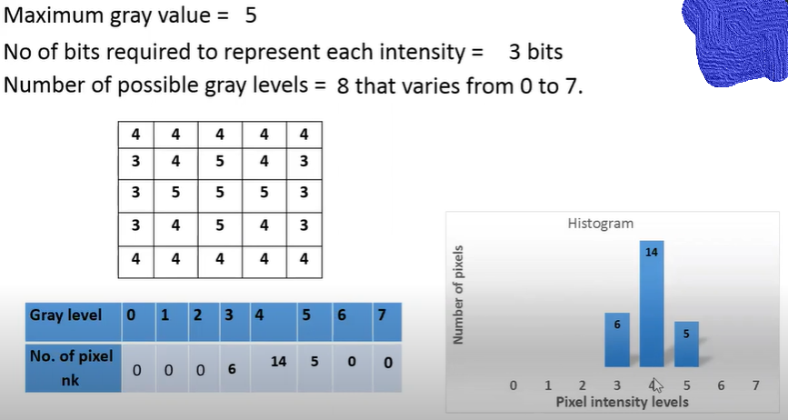

Slide 24
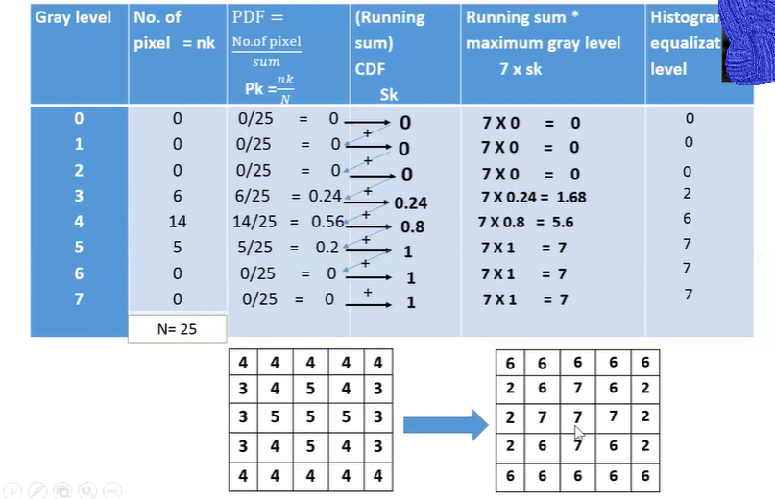

Slide 25
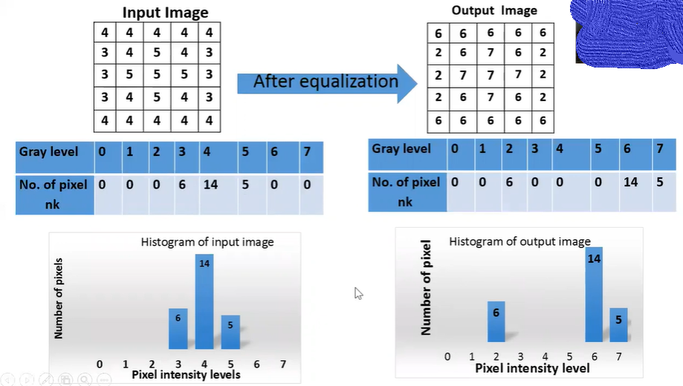

Slide 26
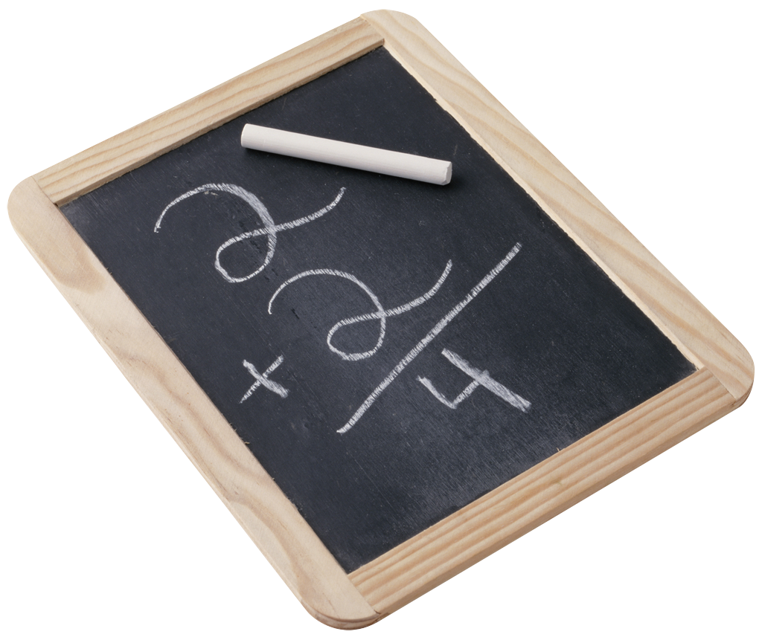
Contrast Stretching
We can fix images that have poor contrast by applying a pretty simple contrast specification
The interesting part is how do we decide on this transformation function?

Slide 27
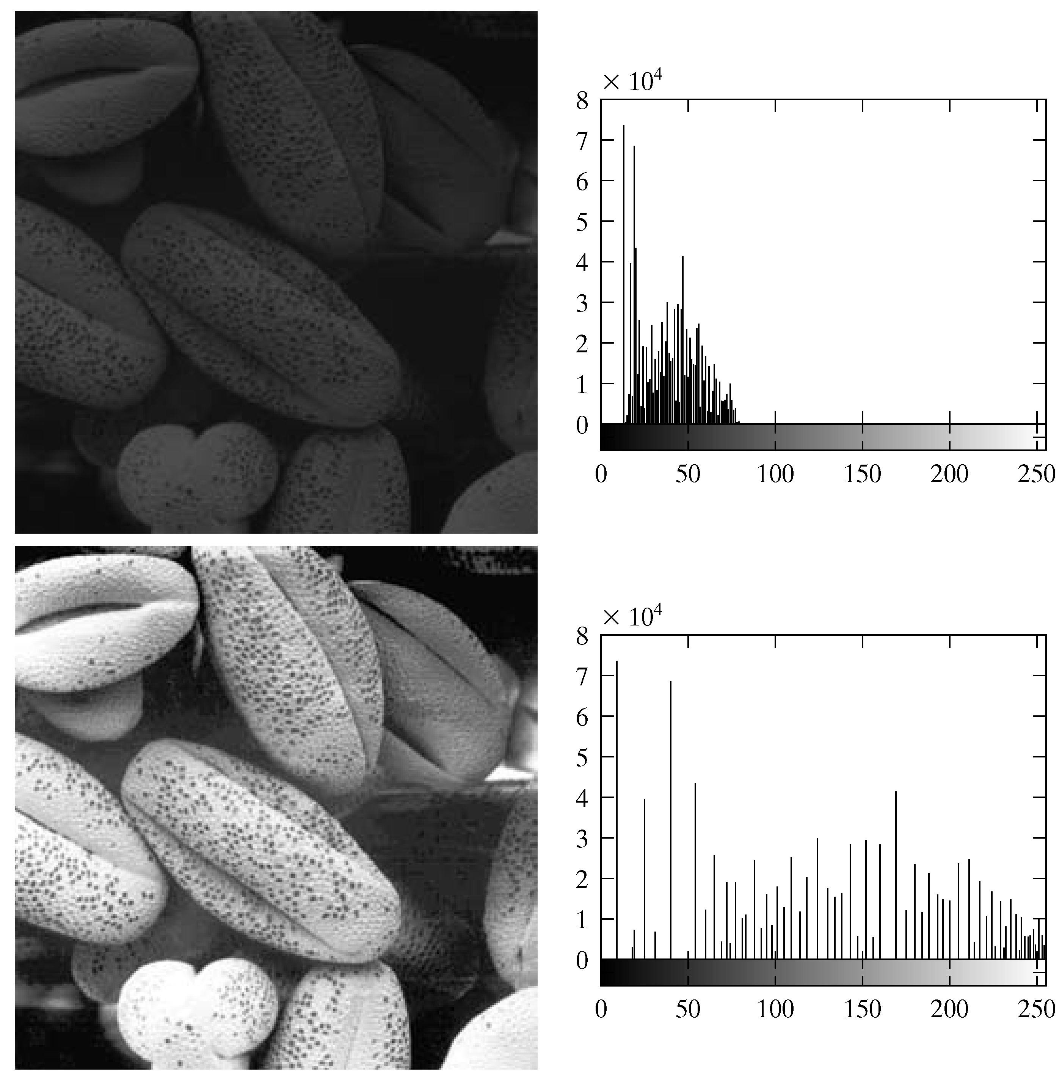
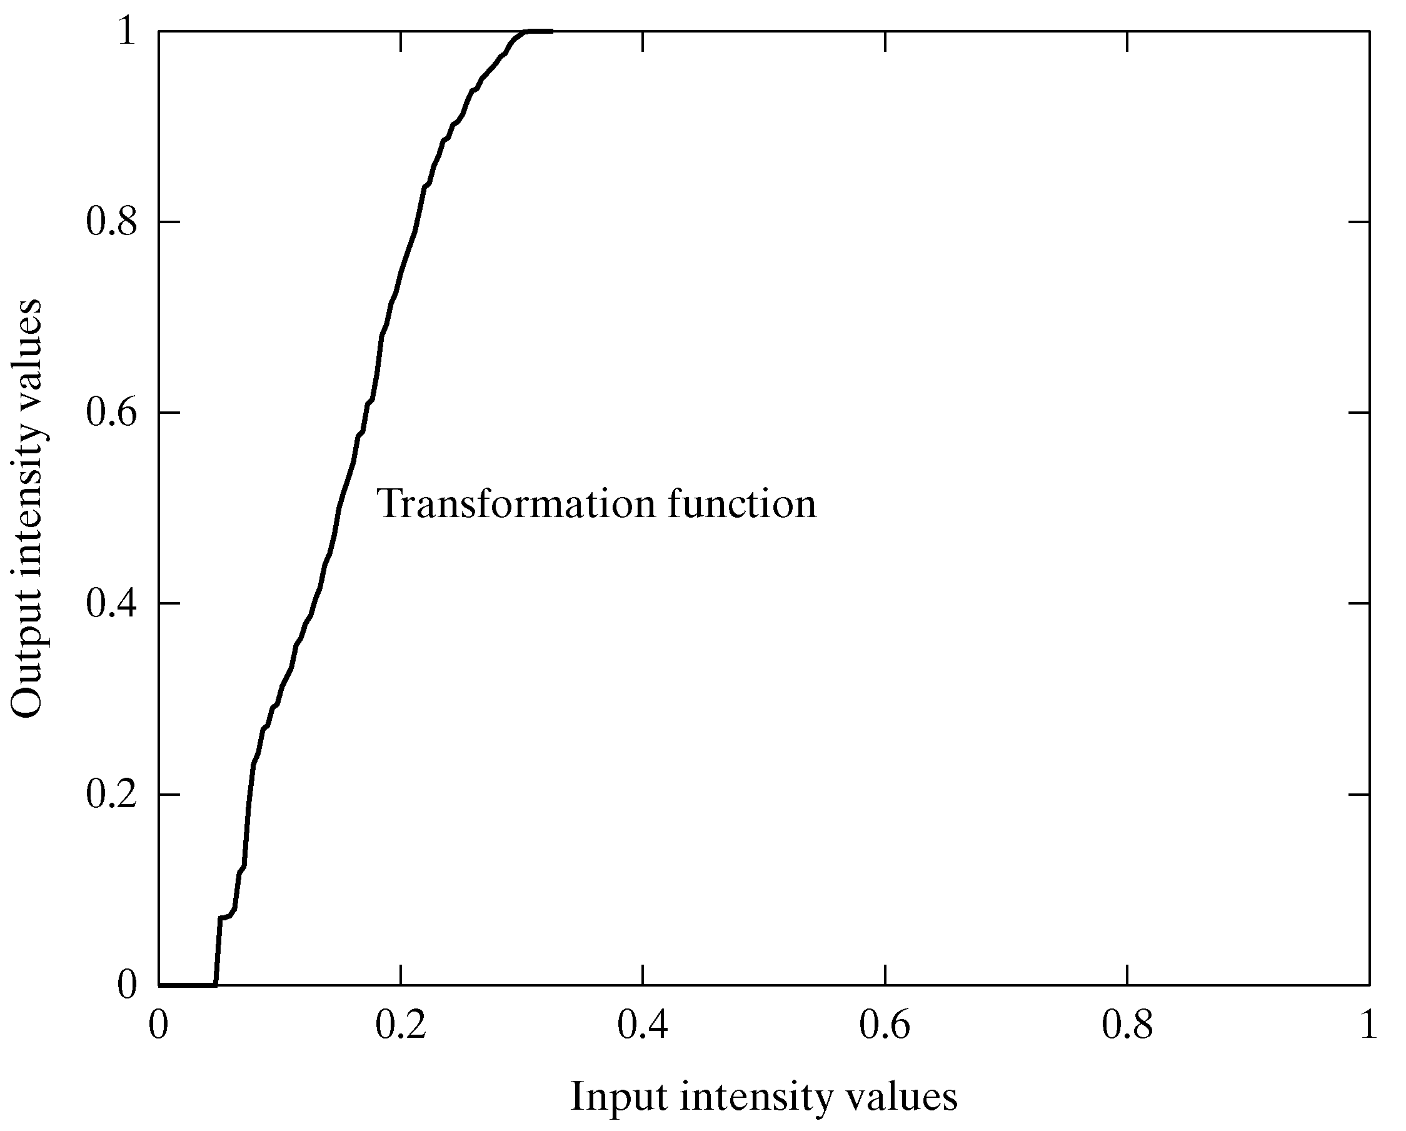
Equalisation Transformation Function
Images taken from Gonzalez & Woods, Digital Image Processing (2002)

Slide 28
H.W
Task
Histogram eq. applications, advantages and drawbacks on digital image
Sample maths

Slide 29
Summary
We have looked at:
Different kinds of image enhancement
Histograms
Histogram equalisation
Next time we will start to look at point processing and some neighbourhood operations

